Slide 1
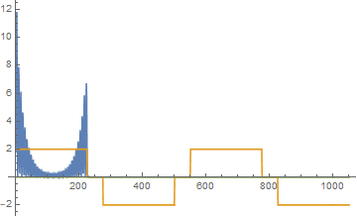
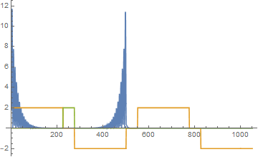
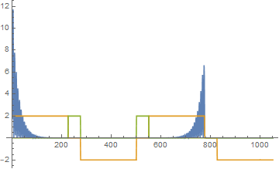
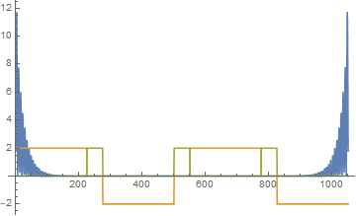
























P
P
$$E={10}^{−3}$$
$$E={10}^{−5}$$
$$200$$
$$400$$
$$600$$
$$800$$
$$1000$$
$$200$$
$$400$$
$$600$$
$$800$$
$$1000$$
Site
Site
P
P
$$E={10}^{−10}$$
$$E={10}^{−7}$$
$$200$$
$$400$$
$$600$$
$$800$$
$$1000$$
$$200$$
$$400$$
$$600$$
$$800$$
$$1000$$
Site
Site

